Slide 1
BFSI Credit Score Case Study
Submitted by:
Nikhil Shingote
Imran Khan
Jayant Srivastava

Slide 2
Problem Statement
SmartLend is a financial institution that lends the money to the people.
SmartLend would like to better understand the primary factors that contribute to a person's credit score based on their demographics and past transactions data.
Using historical information, they wants us to be able to predict which credit bucket a customer would fall into.
SmartLend wants to use this information to make lending decisions more robust and accurate thereby decreasing their credit risk.
Based on the historical data, We have to predict the factors that generally lead to a poor credit score?
We have to build a model for the identification of these customers and to reduce credit risk.

Slide 3
Our Way-out For the Solution
Reading, Understanding and Cleaning the Data.
Univariate Analysis and Bi-variate Analysis.
Data Preparation.
Train-Test Split.
Feature Scaling And Feature Selection Using RFE.
Model Building and Evaluation.
Plotting the ROC Curve and Finding Optimal Cutoff Point
Metrics - Precision and Recall.
Making predictions on the test set.
Final Observation And Recommendations.

Slide 4
Reading, Understanding and Cleaning the Data.
The leads dataset had 100000 rows and 28 columns.
Null values were identified and the columns like Monthly_Inhand_Salary and Type_of_Loan have maximum number of null values i.e. 15.002% and 11.408% respectively.
Since the column Monthly_Inhand_Salary is important for analysis and the missing value count is 15% so we have to impute missing value by best suitable techniques.
We have imputed null value by replacing with random values as it do not distort the distribution.
Since After around 98% percentile the outliers are being detected, so we can cap the above outliers above and below 98% and 2% resp

Slide 5
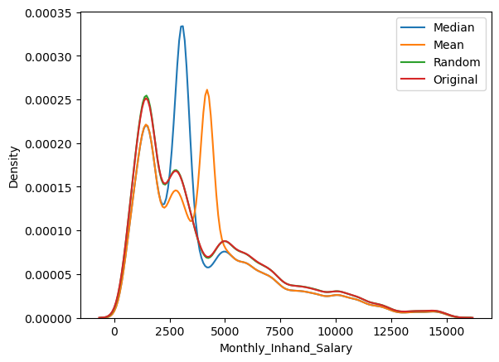
Null Value treatment
Graph representing density curve verses monthly in hand salary.
It is clearly visible that except random value mean and median values are distorting the shape of the curve.
So we have imputed the null values with the random values in the Monthly_Inhand _Salary column.

Slide 6
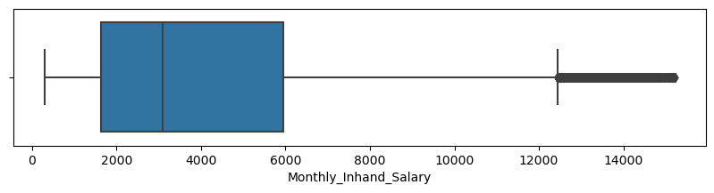
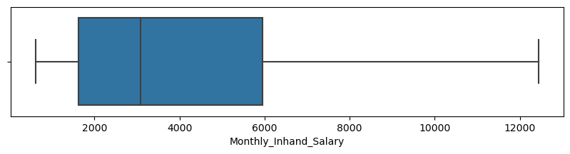
Outlier Treatement.
Monthly_Inhand _Salary column
Graph representing pre and post of boxplot graph of Monthly Inhand salary Coloumn
Since After around 98% percentile the outliers are being detected in the Monthly_Inhand _Salary column
so we can cap the outliers below 2% and above 98%. in the Monthly_Inhand _Salary column.

Slide 7
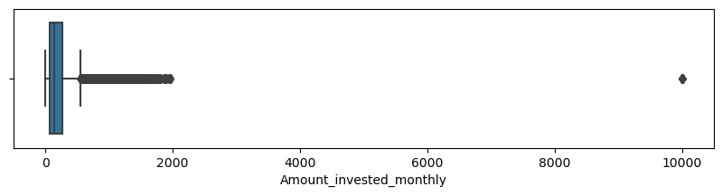
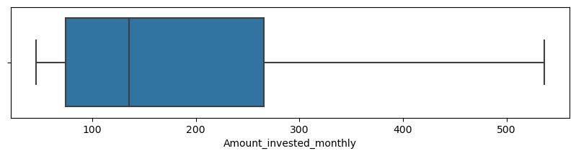
Outlier Treatment.
Amount_invested_monthly Coloumn
Since the column is object datatype and there seem to be "_" value which needs to be removed and convert it into numeric type.
Graph representing pre and post of boxplot graph of Amount invested monthly Column.
Since after 90 percentile the data is stationary so we will cap the above values near 90th percentile
Now there is no outliers present in this column and same is visible in the post boxplot.

Slide 8
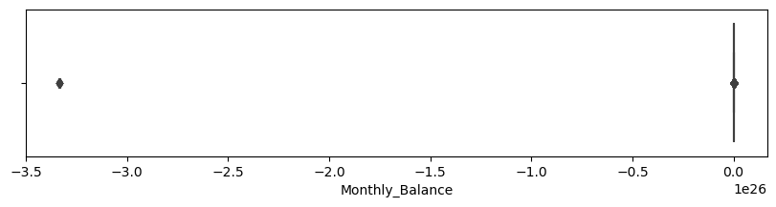
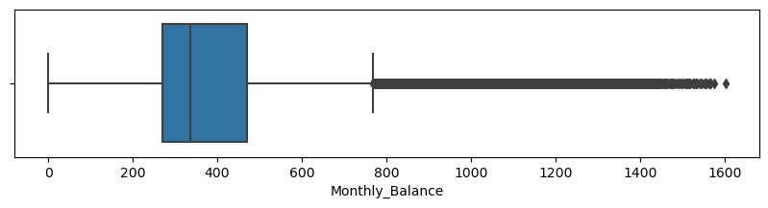
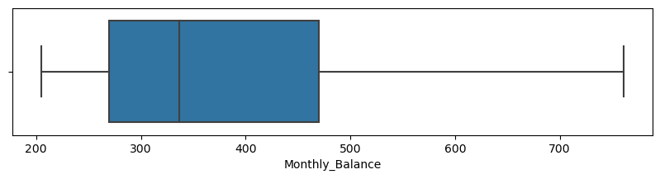
Outlier Treatment.
Monthly Balance Coloumn
Graph representing pre and post of boxplot graph of ‘Monthly_Balance’ Column
Dropping rows with values higher negative value which are not possible in a data
Now there is no outliers present in this column and same is visible in the post boxplot.

Slide 9
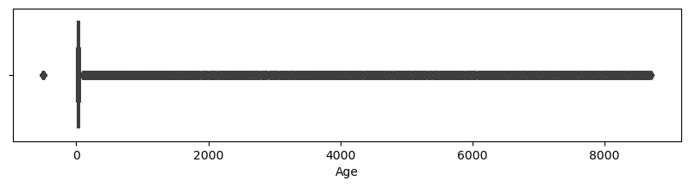
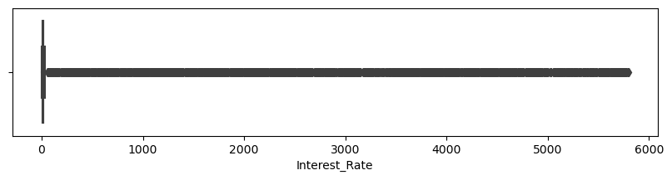
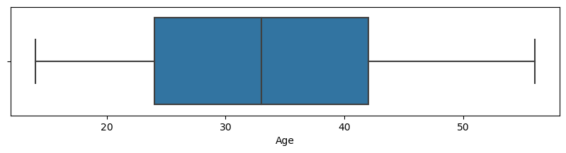
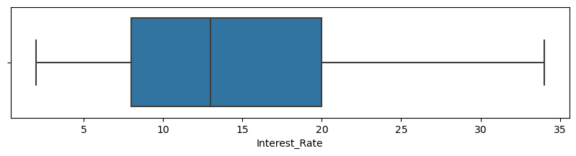
Outlier Treatment.
Other Coloumns
Graph representing pre and post of boxplot graph of other columns are also checked and cleaned
Outlier values are removed by capping the columns

Slide 10
Dropping The Unrequired Columns
Few columns can be dropped as these are not required for analysis
Column like ‘Type_of_Loan’ ‘Num_of_Delayed_Payment’ and ‘Num_Credit_Inquiries, are not required for analysis.
Columns like 'Credit history age’ ,'Years' and 'Months’ are also dropped.

Slide 11
Data Preparation and Creating Dummy variables for categorical columns
Converting 'Payment_of_Min_Amount' column with Yes and No to 1 and 0 resp
Creating a dummy variable for some of the categorical variables and dropping the first one.
Dropping the original columns as we have a dummy features for them.
After Data Preparation and Creating Dummy variables for categorical columns
Data set is rechecked.

Slide 12
Train - Test split & Feature Scaling
Test and Train data splited taking reference of credit score column.
Logistic regression model created from the train data.

Slide 13
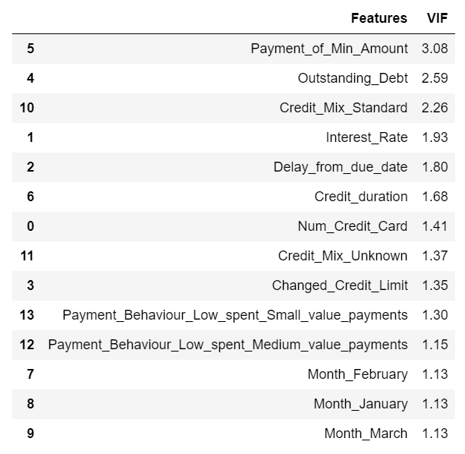
VIF calculation
A data frame created which contain the names of all the feature variables and their respective VIFs
Since the P value for 'Credit_Mix_Good' is higher then the acceptable range we can drop it

Slide 14
Final Recommendations:
For selecting best imputing technique we can see that mostly the random sample selection technique is very useful as it does not distort the dataset and distribution also stays normal.
We can see that Some columns are not useful which will not help in predicting the credit score so its better to not use them.
We can see that Younger generation has poor credit score then mature people has good credit score. So you better concentrate more on people of age less then 25.
People having higher salary have probably good credit score. Concentrate more on people having less salary so there is chance of increasing their credit score.
People investing more have a good credit score as compared to people investing less. so concentrate more on people investing around 150.
People having higher monthly balance usually have good credit score and also lots of people have good score. People having monthly balance around 300 have poor credit score.

